Slide 1
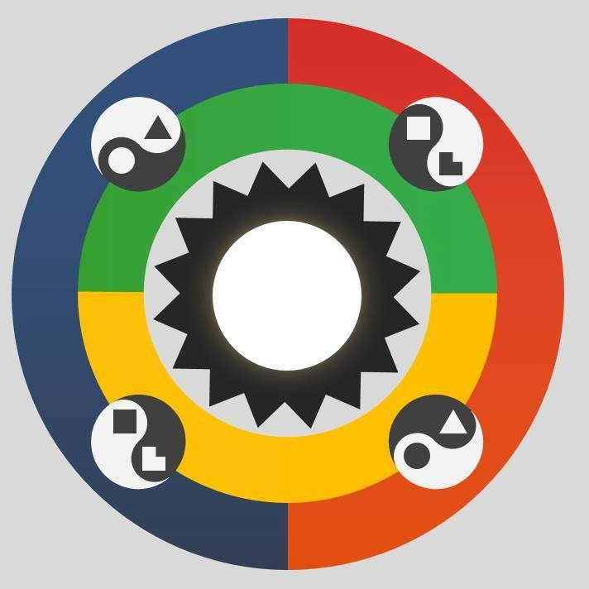
SOCIONICS
All slides are copyrighted by Jack Oliver Aaron of the World Socionics Society
A CRASH COURSE

Slide 2
2. ELEMENTS
Part II
All slides are copyrighted by Jack Oliver Aaron of the World Socionics Society

Slide 3
COVERED SO FAR
All slides are copyrighted by Jack Oliver Aaron of the World Socionics Society
What Socionics is
7x Information Dichotomies

Slide 4
TODAY’S FOCUS
All slides are copyrighted by Jack Oliver Aaron of the World Socionics Society
8x Information Aspects
Information Metabolism
8x Information Metabolism Elements
8x IM Element Blockings

Slide 5
WHAT ARE INFORMATION ASPECTS?
All slides are copyrighted by Jack Oliver Aaron of the World Socionics Society
Metaphysical component of IM Elements
Just the information, not how it’s used
Created by putting together 7 Information Dichotomies

Slide 6
8 Information Aspects
All slides are copyrighted by Jack Oliver Aaron of the World Socionics Society
Domain | Style | Attitude | Aspect
Sensation | Erratic | Repudiating | Force
Sensation | Tranquil | Appreciating | Senses
Intuition | Erratic | Appreciating | Ideas
Intuition | Tranquil | Repudiating | Telos
Logic | Relentless | Differentiating | Pragmatism
Logic | Fixed | Resolving | Laws
Ethics | Relentless | Resolving | Emotions
Ethics | Fixed | Differentiating | Relations

Slide 7
8 Information Aspects (4 Judgements)
All slides are copyrighted by Jack Oliver Aaron of the World Socionics Society
Judgements | Relentless | Fixed
Logic | Pragmatism | Laws
Ethics | Emotions | Relations
Judgements | Differentiating | Resolving
Logic | Pragmatism | Laws
Ethics | Relations | Emotions

Slide 8
8 Information Aspects (4 Perceptions)
All slides are copyrighted by Jack Oliver Aaron of the World Socionics Society
Perceptions | Erratic | Tranquil
Intuition | Ideas | Telos
Sensation | Force | Senses
Perceptions | Appreciating | Repudiating
Intuition | Ideas | Telos
Sensation | Senses | Force

Slide 9
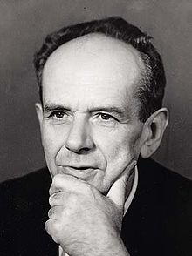
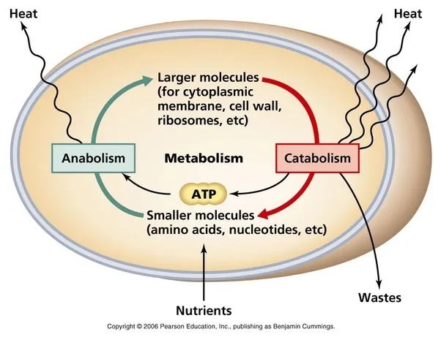
WHAT IS INFORMATION METABOLISM?
All slides are copyrighted by Jack Oliver Aaron of the World Socionics Society
A process
A transformation
A metaphor
Changing of information from one state to another by an organism

Slide 10
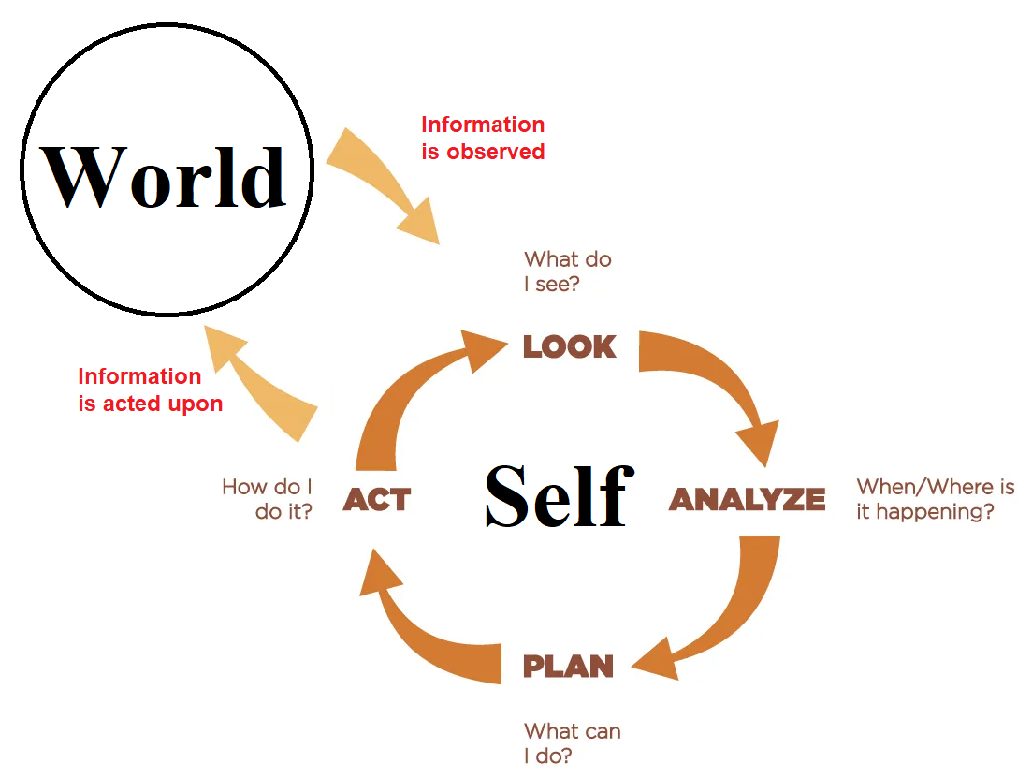
WHAT IS INFORMATION METABOLISM?
All slides are copyrighted by Jack Oliver Aaron of the World Socionics Society

Slide 11
WHAT IS AN INFORMATION METABOLISM ELEMENT?
All slides are copyrighted by Jack Oliver Aaron of the World Socionics Society
Aspects in context of Information Metabolism
What is imputed, outputted and changed
Can be cognitive, motivational, and behavioural
Is assigned to 1 of 8 ‘functions’ for each person

Slide 12
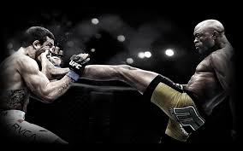
FORCE
All slides are copyrighted by Jack Oliver Aaron of the World Socionics Society
Sensation, Erratic and Repudiating
Extension of each object in physical space
Securing whatever one wants in the material world
Perceiving surrounding threats and advantages
Assertive, tactical, action-oriented

Slide 13

SENSES
All slides are copyrighted by Jack Oliver Aaron of the World Socionics Society
Sensation, Tranquil and Appreciating
The physical environment in which things happen
Maintaining balance and quality of experience
Perceiving how details affect flow in the moment
Peaceful, grounded, detail-aware

Slide 14

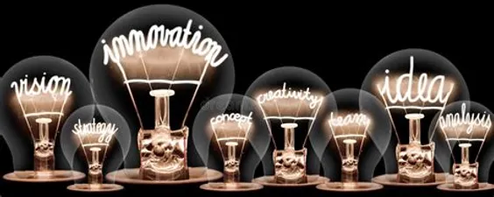
IDEAS
All slides are copyrighted by Jack Oliver Aaron of the World Socionics Society
Intuition, Erratic and Appreciating
The potential of each object to someday exist
Exploring and enabling new possibilities to happen
Perceiving alternative ideas and perspectives
Curious, whimsical, open-minded

Slide 15

TELOS
All slides are copyrighted by Jack Oliver Aaron of the World Socionics Society
Intuition, Tranquil and Repudiating
The temporal stream of past to present to future
Focusing awareness on significant outcomes
Perceiving trends and ultimate trajectory of events
Reflective, strategic, and ‘big picture’-oriented

Slide 16
All slides are copyrighted by Jack Oliver Aaron of the World Socionics Society
VS.
Acts immediately
Direct
Take it head on
Speculates on options
Indirect
Find another way

Slide 17
All slides are copyrighted by Jack Oliver Aaron of the World Socionics Society
VS.
Smells the roses
Present
Everyday living
Leaves trivia behind
Removed
Bigger picture

Slide 18
All slides are copyrighted by Jack Oliver Aaron of the World Socionics Society
VS.
Assertive
Intensity-seeking
Disruptive
Go with the flow
Comfort-seeking
Keep the peace

Slide 19
All slides are copyrighted by Jack Oliver Aaron of the World Socionics Society
VS.
Open to ideas
Why not try it?
Possibility
Committed to vision
What’s the point?
Inevitability

Slide 20

PRAGMATISM
All slides are copyrighted by Jack Oliver Aaron of the World Socionics Society
Logic, Relentless and Differentiating
Operation of empirically-verifiable processes
Maximising the effectiveness of how things work
Judging accuracy and best application of facts
Factual, knowledgeable and pragmatic

Slide 21

LAWS
All slides are copyrighted by Jack Oliver Aaron of the World Socionics Society
Logic, Fixed and Resolving
Frameworks of logical connections between facts
Formulating rules that make clear sense of things
Judging what is consistent or contradicts
Principled, truth-seeking, structure-oriented

Slide 22
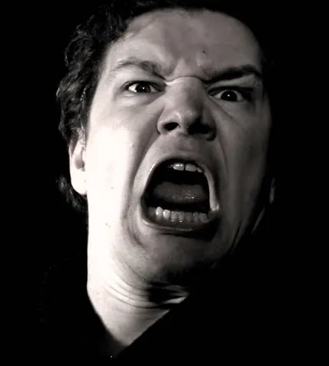

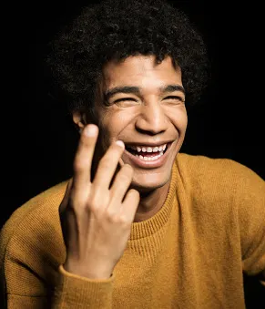
EMOTIONS
All slides are copyrighted by Jack Oliver Aaron of the World Socionics Society
Ethics, Relentless and Resolving
Ebbs and flows of moods and emotional energies
Expressing emotions to enliven how people feel
Judging most authentic, appropriate expressions
Enthusiastic, passionate, charismatic

Slide 23
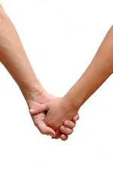

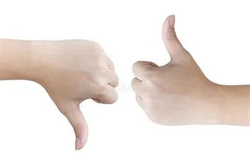
RELATIONS
All slides are copyrighted by Jack Oliver Aaron of the World Socionics Society
Ethics, Fixed and Differentiating
Personal attitudes towards people and things
Establishing relationships in line with attitudes
Judging goodness and badness of intentions
Sincere, evaluative, loyal

Slide 24
All slides are copyrighted by Jack Oliver Aaron of the World Socionics Society
VS.
Factually true
Dry, matter of fact
Fully informs
Emotionally authentic
Exaggerates for effect
Says what people want

Slide 25
All slides are copyrighted by Jack Oliver Aaron of the World Socionics Society
VS.
Impartial
Same for everyone
Objective rules
Loyalty-driven
Based on like/dislike
Personal opinion

Slide 26
All slides are copyrighted by Jack Oliver Aaron of the World Socionics Society
VS.
How does it work?
Tested and updated
Whatever works best
What is it essentially?
Ordained by principles
Must be consistent

Slide 27
All slides are copyrighted by Jack Oliver Aaron of the World Socionics Society
VS.
Group mood
Behaviours
Authentic expression
1-to-1 attitudes
Intentions
Loyal to relationships

Slide 28
MORE ON INFORMATION METABOLISM
All slides are copyrighted by Jack Oliver Aaron of the World Socionics Society

Slide 29
EXTROVERTED INFORMATION METABOLISM
All slides are copyrighted by Jack Oliver Aaron of the World Socionics Society
How things are working enables new opportunities
Seeing new ideas can inspire strong feelings
Powerful emotions motivate people to act
Action impacts on reality and creates results

Slide 30
INTROVERTED INFORMATION METABOLISM
All slides are copyrighted by Jack Oliver Aaron of the World Socionics Society
Strong relationships create peaceful conditions
Stability allows the creation of rules and traditions
Clear rules enables the prediction of future outcomes
Knowing future outcomes allows us to pick rewarding relationships

Slide 31
EXTROVERTED IM COUNTERFACTUAL
All slides are copyrighted by Jack Oliver Aaron of the World Socionics Society
No more data means no new ideas
No new ideas mean no inspiration
No inspiration, no motivation to act
No action, no change to how things work

Slide 32
INTROVERTED IM COUNTERFACTUAL
All slides are copyrighted by Jack Oliver Aaron of the World Socionics Society
Broken relationships ruin the harmony
Disharmony ends rule of law
Chaos makes it impossible to predict the future
Without a knowable future there is no point building relationships

Slide 33
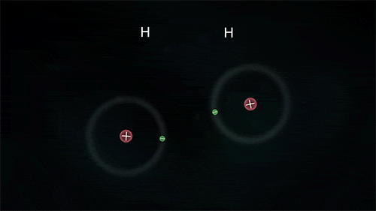
WHAT IS BLOCKING?
All slides are copyrighted by Jack Oliver Aaron of the World Socionics Society
IM Elements are ‘highly reactive’
Bond into blocks
Each Element may block with 2 others
Rules for blocking:
Extroverted + Introverted
Rational + Irrational
Static + Static OR Dynamic + Dynamic

Slide 34
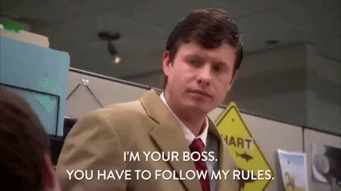
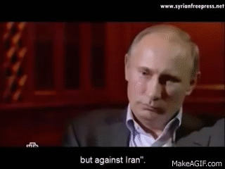
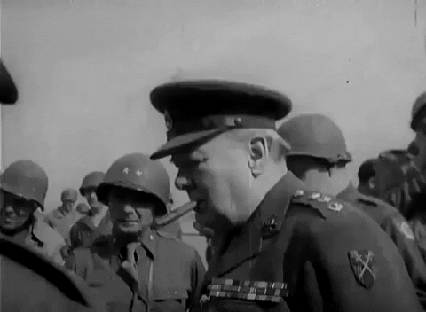
FORCE + LAWS
All slides are copyrighted by Jack Oliver Aaron of the World Socionics Society
Static, External and Conclusive
Hierarchy
Code of honour
Law enforcement
Ideological conflict

Slide 35
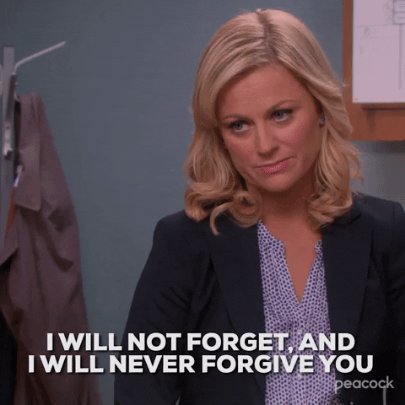
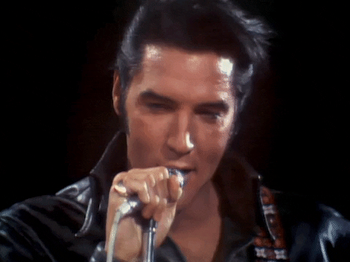
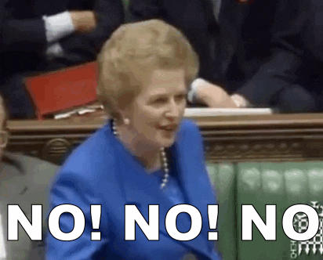
FORCE + RELATIONS
All slides are copyrighted by Jack Oliver Aaron of the World Socionics Society
Static, Involved & Repulsive
Personal boundaries
Bonds of loyalty
Character judgement
Vengeance

Slide 36
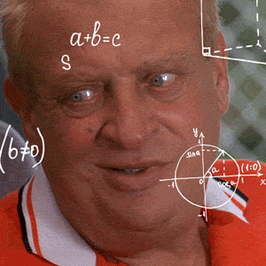
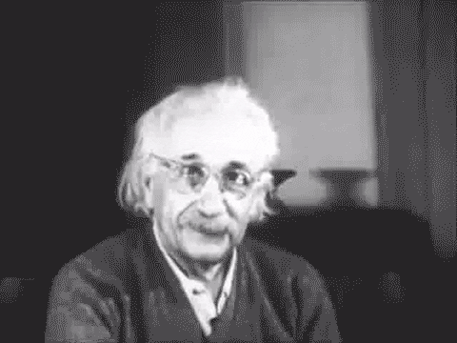
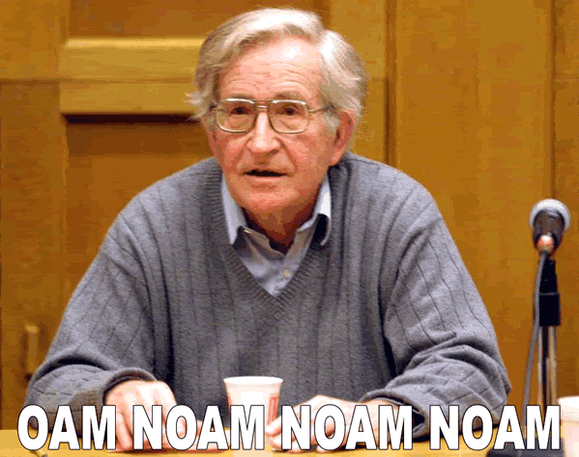
IDEAS + LAWS
All slides are copyrighted by Jack Oliver Aaron of the World Socionics Society
Static, Detached & Attractive
Grand theories
Concepts
Definitions
Thought Experiments

Slide 37
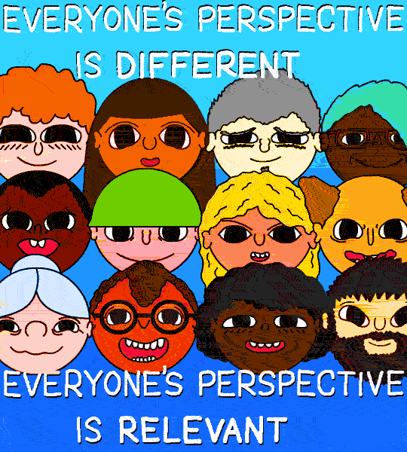
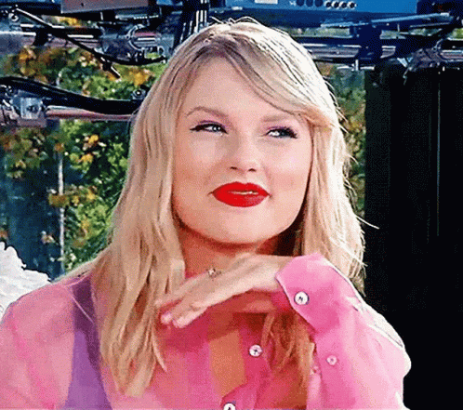

IDEAS + RELATIONS
All slides are copyrighted by Jack Oliver Aaron of the World Socionics Society
Static, Internal and Questionable
Perspectives
Intentions
Personal potential
Benefit of the doubt

Slide 38
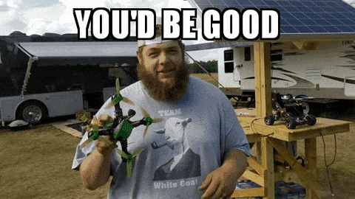
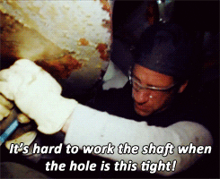
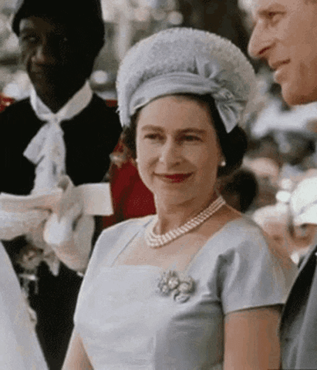
PRAGMATISM + SENSES
All slides are copyrighted by Jack Oliver Aaron of the World Socionics Society
Dynamic, External and Questionable
Practicality
Empirical testing
Work quality
Self-sufficiency

Slide 39
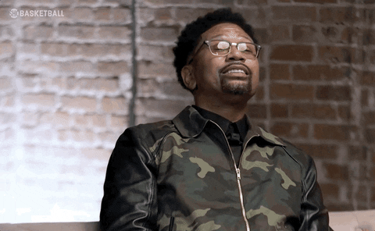
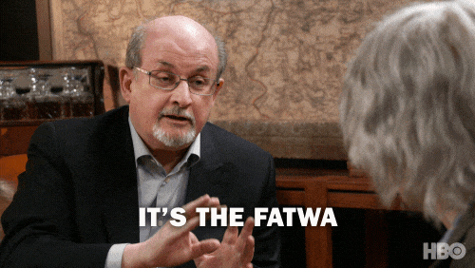
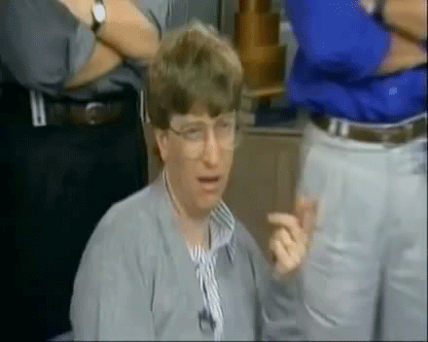
Pragmatism + Telos
All slides are copyrighted by Jack Oliver Aaron of the World Socionics Society
Dynamic, Detached and Repulsive
Strategy
Scepticism
Goal-orientation
Independence

Slide 40
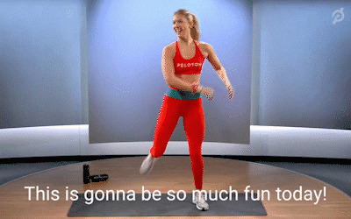
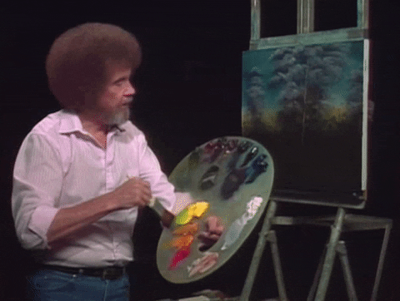
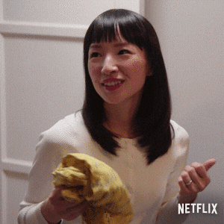
Emotions + Senses
All slides are copyrighted by Jack Oliver Aaron of the World Socionics Society
Dynamic, Involved and Attractive
Positivity
Inclusivity
Comfort
Fun

Slide 41
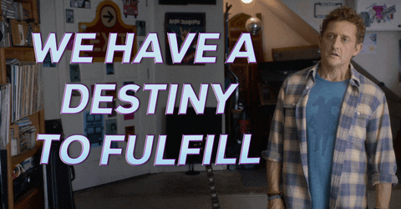

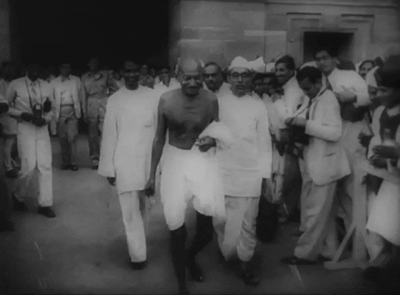
Emotions + Telos
All slides are copyrighted by Jack Oliver Aaron of the World Socionics Society
Dynamic, Internal and Conclusive
Authentic expression
Exclusive belonging
Romanticism
‘Just knowing’ destiny

Slide 42
Exercise
All slides are copyrighted by Jack Oliver Aaron of the World Socionics Society
Keeping a bad guy at a distance
Being destined for greatness
The 10 commandments
Something surprising about a person
Fermenting cocoa beans
A 5 year career plan
The theory of Socionics
A warm hug
Try to find the block of two Elements making this up:

Slide 43
Next Time
All slides are copyrighted by Jack Oliver Aaron of the World Socionics Society
1. Leading | 2. Creative
4. Vulnerable | 3. Role
6. Mobilising | 5. Suggestive
7. Ignoring | 8. Demonstrative

Slide 44
Any Questions?
All slides are copyrighted by Jack Oliver Aaron of the World Socionics Society
Email Jack at worldsocionics@hotmail.com

